Slide 1
God as man in the Old Testament
Then Moses and Aaron, Nadab, and Abihu, and seventy of the elders of Israel went up, and they saw the God of Israel . . . (Exod 24:9-10a)

Slide 2
Deut 6:4
﻿Hear, O Israel, the LORD our God, the LORD is one.

Slide 3
How is it that a first century Jew, so committed to monotheism that he or she would choose death rather than worship the Roman emperor or a Roman god, could embrace Jesus of Nazareth as God in the flesh alongside the God of Israel?
Why was this not conceived of as a violation of the Shema and rejection of monotheism?

Slide 4
Introducing judaism’s Two Powers in heaven

Slide 5
Genesis 19:24
YHWH rained upon Sodom and Gomorrah sulfurous fire from YHWH out of heaven.
Tanakh: The Holy Scriptures: A New Translation of the Holy Scriptures According to the Traditional Hebrew Text. Philadelphia: Jewish Publication Society (1997)

Slide 6
Genesis 19:24
YHWH rained upon Sodom and Gomorrah sulfurous fire from YHWH out of heaven.
Tanakh: The Holy Scriptures: A New Translation of the Holy Scriptures According to the Traditional Hebrew Text. Philadelphia: Jewish Publication Society (1997)

Slide 7
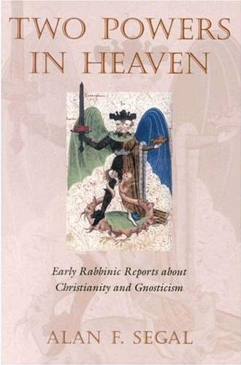
The idea of the 2nd power was not considered heretical until the 2nd century CE.
Segal, Two Powers in Heaven, pp. x-xi (Introduction)

Slide 8
Daniel 7:9
As I looked on, Thrones were set in place, And the Ancient of Days took His seat. His garment was like white snow, And the hair of His head was like lamb’s wool. His throne was tongues of flame; Its wheels were blazing fire. . .
(other description)

Slide 9
Daniel 7:13
The court sat and the books were opened. . . . One like a human being / son of man came with the clouds of heaven. . . Dominion, glory, and kingship were given to him.

Slide 10
Segal:
“[Daniel 7] may easily be describing two separate, divine figures. More than one throne is revealed and scripture describes two divine figures to fill them.”
Not only 2 thrones
COURT was seated

Slide 11
Israel’s TWO Yahwehs

Slide 12
The ANGEL & The NAME

Slide 13
Exodus 3
1 Now Moses, tending the flock of his father-in-law Jethro, the priest of Midian, drove the flock into the wilderness, and came to Horeb, the mountain of God. ﻿2 ﻿An angel of YHWH appeared to him in a blazing fire out of a bush. . . . ﻿4﻿ When YHWH saw that he had turned aside to look, God called to him out of the bush: “Moses! Moses!” He answered, “Here I am.”
﻿
﻿
Notes:
Go to ESV Reverse Interlinear at Joshua 5:13, search on TEXT form for “drawn”

Slide 14
Exodus 23
﻿20 ﻿ I am sending an angel before you to guard you on the way and to bring you to the place that I have made ready. ﻿21﻿ Pay heed to him and obey him. Do not defy him, for he will not pardon your offenses, since My Name is in him …
﻿
﻿
Notes:
Go to ESV Reverse Interlinear at Joshua 5:13, search on TEXT form for “drawn”

Slide 15
Deuteronomy 12
⁴ Do not worship the Lord your God in like manner, ⁵ but look only to the site that the Lord your God will choose amidst all your tribes as His habitation, to establish His name there. There you are to go . . . ¹¹ you must bring everything that I command you to the site where the Lord your God will choose to establish His name . . .

Slide 16
Psalm 20:1, 7
May the Lord answer you in the day of trouble!
May the name of the God of Jacob protect you!
Some trust in chariots and some in horses, but we trust in the name of the Lord our God.

Slide 17
Isaiah 30:27
Behold the Name of the Lord Comes from afar In blazing wrath, With a heavy burden— His lips full of fury, His tongue like devouring fire,

Slide 18
Exodus 23
﻿20 ﻿ I am sending an angel before you to guard you on the way and to bring you to the place that I have made ready. ﻿21﻿ Pay heed to him and obey him. Do not defy him, for he will not pardon your offenses, since My Name is in him; ﻿22﻿ but if you obey him and do all that I say, I will be an enemy to your enemies and a foe to your foes.
﻿
﻿
Notes:
Go to ESV Reverse Interlinear at Joshua 5:13, search on TEXT form for “drawn”

Slide 19
Deuteronomy 4:35-37
³⁵ To you it was shown, ﻿that you might know that the Lord is God; ﻿there is no other besides him. . . . ³⁷ And because ﻿he loved your fathers and chose their offspring after them﻿ and brought you out of Egypt ﻿with his own presence (panim) by his great power…
﻿
﻿
Notes:
Go to ESV Reverse Interlinear at Joshua 5:13, search on TEXT form for “drawn”

Slide 20
Judges 2
﻿1 The angel of YHWH came up from Gilgal to Bochim and said, “I brought you up from Egypt and I took you into the land which I had promised on oath to your fathers. And I said, ‘I will never break My covenant with you. ﻿2﻿ And you, for your part, must make no covenant with the inhabitants of this land; you must tear down their altars.’ But you have not obeyed Me—look what you have done! ﻿﻿
﻿
﻿
Notes:
Go to ESV Reverse Interlinear at Joshua 5:13, search on TEXT form for “drawn”

Slide 21
Genesis 31:10-13
¹⁰ In the breeding season of the flock I lifted up my eyes and saw in a dream that the goats that mated with the flock were striped, spotted, and mottled. ¹¹ Then the angel of God said to me in the dream, ‘Jacob,’ and I said, ‘Here I am!’ ¹² And he said, ‘Lift up your eyes and see, all the goats that mate with the flock are striped, spotted, and mottled, for I have seen all that Laban is doing to you. ¹³ I am the God of Bethel, where you anointed a pillar and made a vow to me. Now arise, go out from this land and return to the land of your kindred.’ ”

Slide 22
Genesis 48:14-16
¹⁴ But Israel [i.e., Jacob] stretched out his right hand and laid it on Ephraim’s head, though he was the younger, and his left hand on Manasseh’s head—thus crossing his hands—although Manasseh was the first-born. ¹⁵ And he blessed Joseph, saying:
“The God in whose ways my fathers Abraham and Isaac walked;
The God who has been my shepherd from my birth to this day—
The Angel who has redeemed me from all harm—
May he bless these lads.”

Slide 23
The WORD

Slide 24
Genesis 15
¹ After these things the word of the Lord came to Abram in a vision, “Do not be afraid, Abram, I am your shield; your reward shall be very great.”

Slide 25
1 Samuel 3
¹ Now the young man Samuel was ministering to the Lord (YHWH) under Eli. And the word of the Lord was rare in those days; there was no frequent vision . . .
^{﻿7﻿}Now Samuel had not yet experienced the Lord; the word of the Lord had not yet been revealed to him. ⁸ And the Lord called Samuel again the third time . . .

Slide 26
¹⁰ And the LORD (YHWH) came and stood, calling as at other times, “Samuel! Samuel!” And Samuel said, “Speak, for your servant hears.”
¹⁹ And Samuel grew, and the LORD (YHWH) was with him and let none of his words fall to the ground. ²⁰ And all Israel from Dan to Beersheba knew that Samuel was established as a prophet of the Lord. ²¹ And the LORD (YHWH) appeared again at Shiloh, the LORD (YHWH) revealed himself to Samuel at Shiloh by/as the word of the Lord.

Slide 27
Jeremiah 1
⁴ Now the word of the Lord came to me saying, ⁵ “Before I formed you in the womb I knew you. . . .” ⁶ Then I said, “Ah, Lord God (YHWH elohim)! Truly I do not know how to speak, for I am only a boy.” ⁷ But the LORD (YHWH) said to me, “Do not say, ‘I am only a boy’; for you shall go to all to whom I send you . . . ⁹ Then the LORD (YHWH) put out his hand and touched my mouth; and the LORD (YHWH) said to me, “Now I have put my words in your mouth.

Slide 28
The “Cloud-Rider”

Slide 29
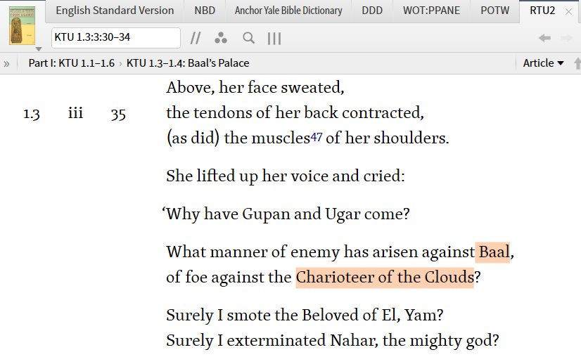
“He Who Rides the Clouds”

Slide 30
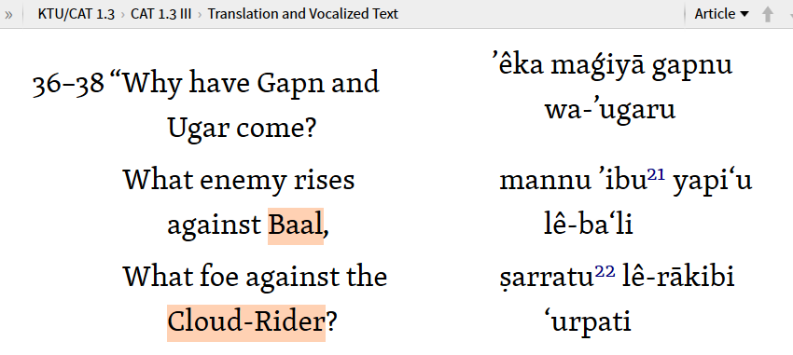
“He Who Rides the Clouds”

Slide 31
Deuteronomy 33
²⁶ “There is none like God, O Jeshurun, who rides through the heavens to your help, through the skies in his majesty.

Slide 32
Psalm 68
³² O kingdoms of the earth, sing to God; sing praises to the LORD (YHWH) , Selah ³³ to him who rides in the heavens, the ancient heavens. . . .

Slide 33
Psalm 104
1 Bless the Lord, O my soul! O LORD (YHWH) my God, you are very great! You are clothed with splendor and majesty, ² covering yourself with light as with a garments stretching out the heavens like a tent. ³ He lays the beams of his chambers on the waters; he makes the clouds his chariot; he rides on the wings of the wind.

Slide 34
Isaiah 19
An oracle concerning Egypt.
Behold, the Lord is riding on a swift cloud and comes to Egypt; and the idols of Egypt will tremble at his presence, and the heart of the Egyptians will melt within them.

Slide 35
Jesus Against this Backdrop

Slide 36
The Word
John 1:1-3, 14
¹ In the beginning was the Word, and the Word was with God, and the Word was God. ² He was in the beginning with God. ³ All things were made through him, and without him was not any thing made that was made . . . ¹⁴ And the Word became flesh and dwelt among us, and we have seen his glory, glory as of the only Son from the Father, full of grace and truth.

Slide 37
The Angel
Jude 5
⁵ Now I want to remind you, although you once fully knew it, that Jesus, who saved a people out of the land of Egypt, afterward destroyed those who did not believe.

Slide 38
The Name
John 17
⁶ ﻿“I have manifested your name to the people ﻿whom you gave me out of the world. ﻿Yours they were, and you gave them to me, and they have kept your word.
¹² ﻿While I was with them, I kept them in/by your name, which you have given me.
²⁶ ﻿I made known to them your name, and I will continue to make it known, that the love ﻿with which you have loved me may be in them, and ﻿I in them.”

Slide 39
Rider on the Clouds
¹³ I saw in the night visions, and behold, upon the clouds of heaven there came one like a son of man, and he came to the Ancient of Days and was presented before him.

Slide 40
Matthew 26
⁵⁷ Then those who had seized Jesus led him to Caiaphas the high priest, where the scribes and the elders had gathered. … ⁶² And the high priest stood up and said, “Have you no answer to make? What is it that these men testify against you?” ⁶³ But Jesus remained silent. And the high priest said to him, “I adjure you by the living God, tell us if you are the Christ, the Son of God.” ⁶⁴ Jesus said to him, “You have said so. But I tell you, from now on you will see the Son of Man seated at the right hand of Power and coming on the clouds of heaven.” ⁶⁵ Then the high priest tore his robes and said, “He has uttered blasphemy. What further witnesses do we need? You have now heard his blasphemy.

Slide 41
Trinity in the OT?

Slide 42
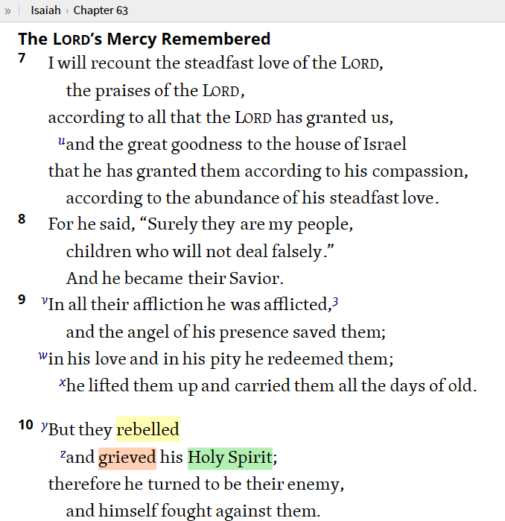
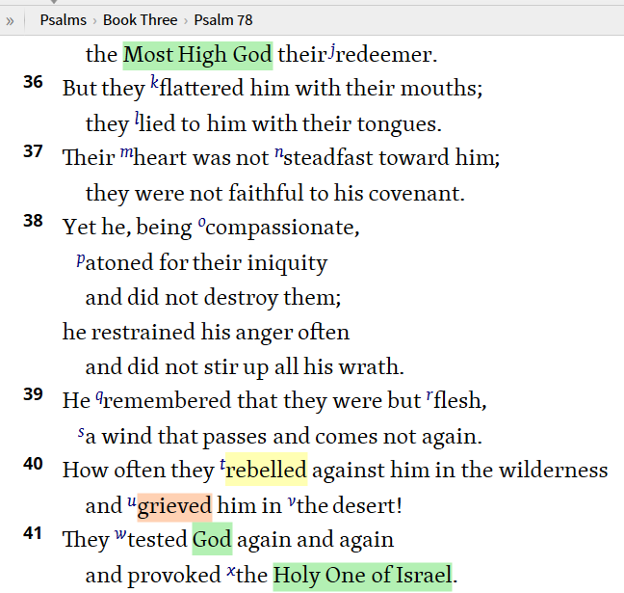

Slide 43
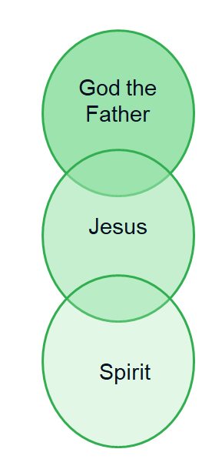
Two (& Three) Powers: OT - NT
YHWH
Acts 16:6-7
HS = “Spirit of Jesus”
(Phil 1:19)
Rom 8:9
Spirit of God = “Spirit
of Christ” (1 Pet 1:11)
Gal 4:6 – God sent “Spirit of his Son” into our hearts
2nd (visible) YHWH
Spirit

Slide 44
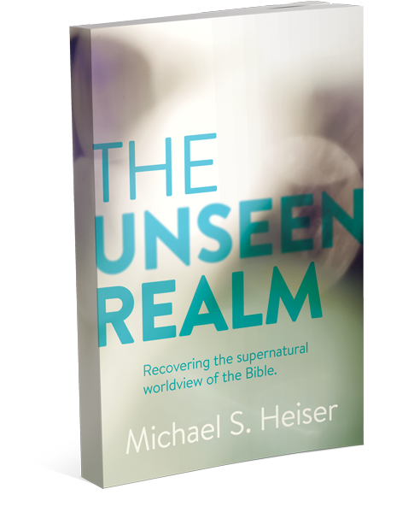
Naked Bible Podcast

