Slide 1
Supernatural Worldview of the Bible
Cosmic Geography

Slide 2
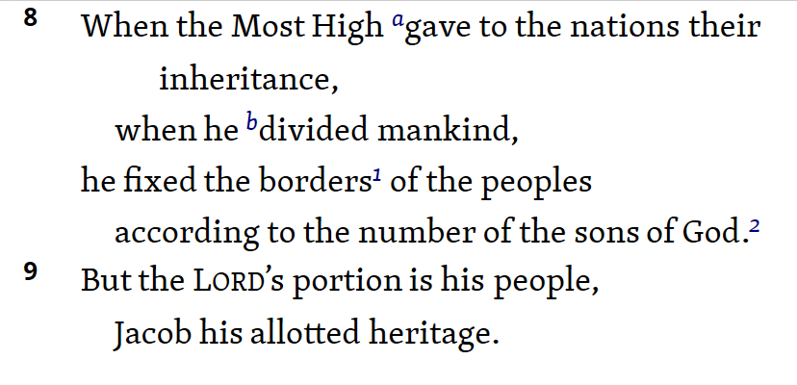
Babel (Gen 11; Deut 32:8-9)

Slide 3
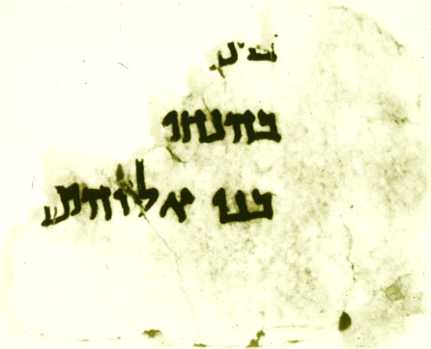
Sons of God or Sons of Israel?
Michael S. Heiser, “Deuteronomy 32:8 and the Sons of God,” Bibliotheca Sacra 158 (January-March 2001): 52–74

Slide 4
Babel & Deut 32:8-9: What’s Up?
Nations divided at tower of Babel
Nations = Gen 10 “Table of Nations”
Israel didn’t exist at the time
“sons of Israel” makes no sense.

Slide 5
Babel & Deut 32:8-9
Disinheriting of the nations (Gen 10)
Not permanent
Genesis 12 = Call of Abram to create a new for Himself (His “portion” – Deut 32:9)
Promised seed / blessing (Gen 12:3)
Exod 19:5-6 - “kingdom of priests”
Acts 17:24-27
Disaster of Psalm 82

Slide 6
OT Cosmic Geography
Explains a number of passages.
For example:
Daniel 10:13, 20-21 (cp. Dan 12:1)
1 Sam 5:1-5
1 Samuel 26:17-19
2 Kings 5:17-19

Slide 7
The Ministry of Jesus
Inaugurating the kingdom

Slide 8
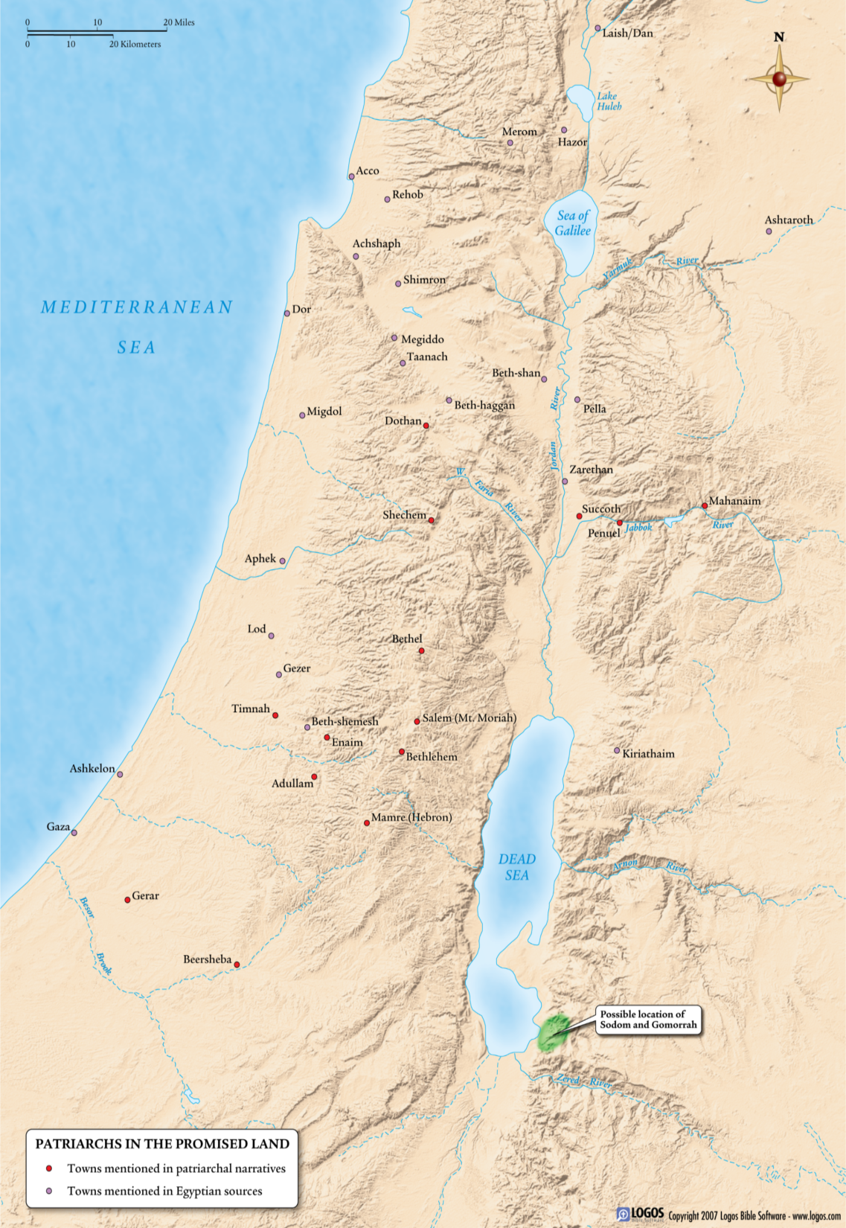
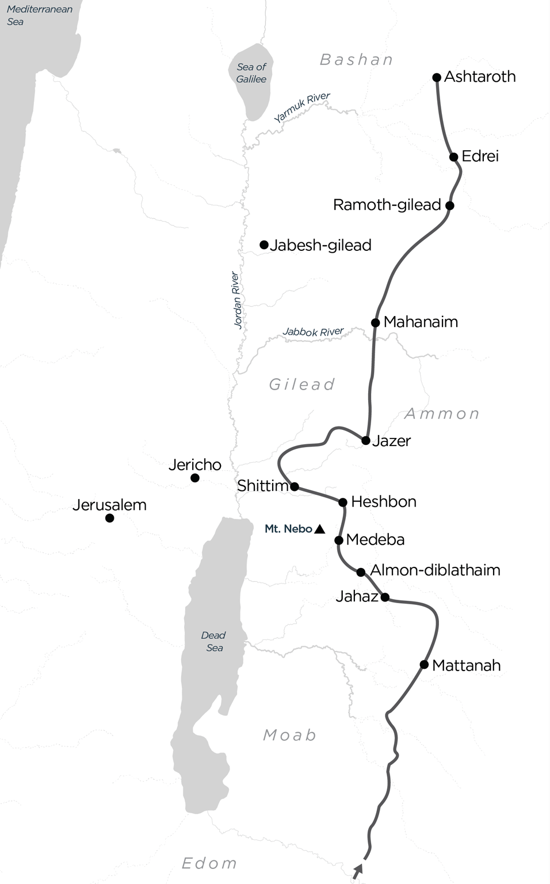

Slide 9
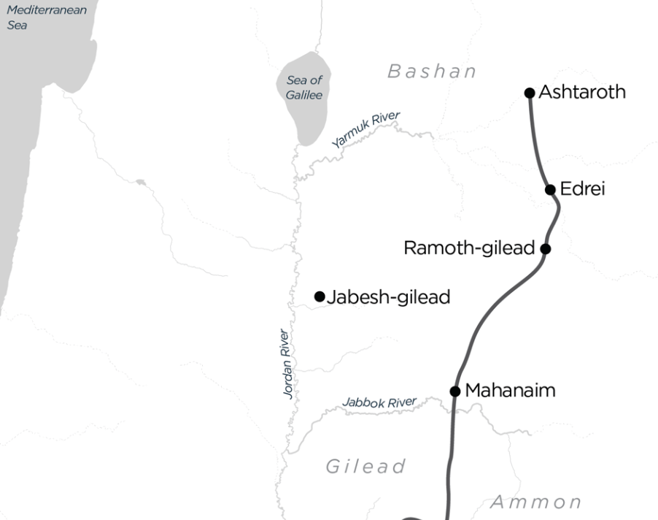

Slide 10
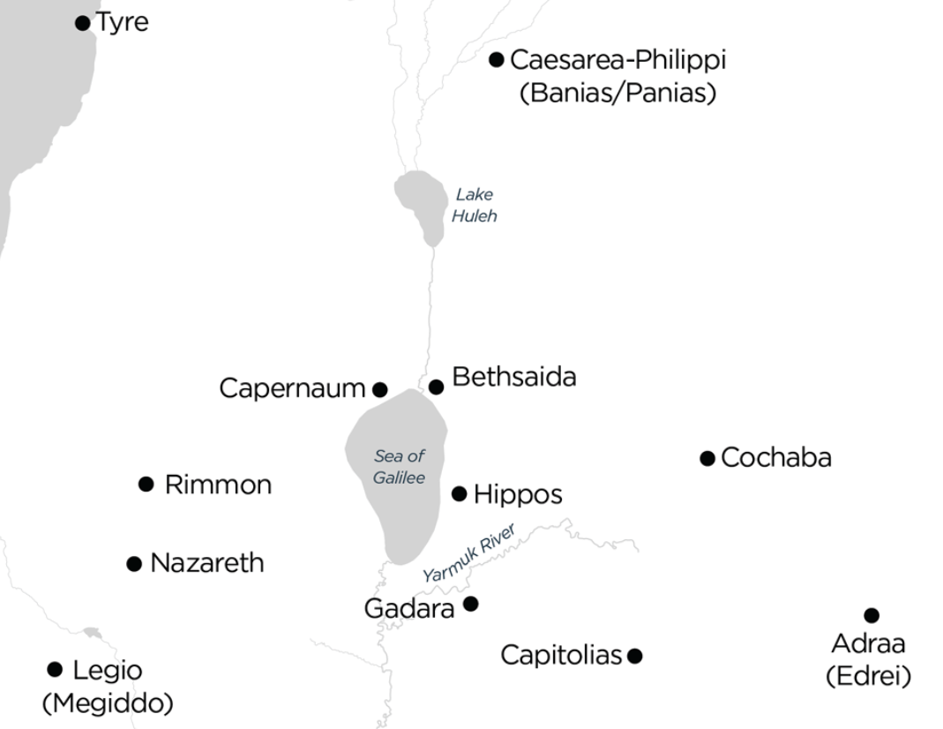

Slide 11
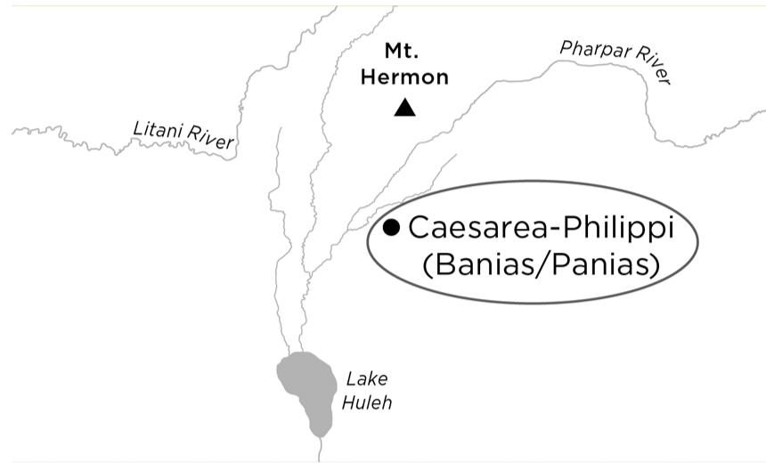

Slide 12
Bashan
BASHAN (THE) . . . It borders on Mount Hermon on the north and the Gilead in the south (Deut. 3:8–10; Josh. 12:1–5). The River Yarmuk forms the boundary between the Bashan and Gilead.
Avraham Negev, The Archaeological Encyclopedia of the Holy Land (New York: Prentice Hall Press, 1990).

Slide 13
Jesus & Cosmic Geography
Caesarea Philippi / Banias / Panias
Mark 8:27-30 (Matt 16:13-16; Lk 9:18-20)
Peter’s Confession (﻿”And Jesus went on with his disciples to the villages of Caesarea Philippi”)

Slide 14
Jesus & Cosmic Geography
“Gates of Hell”
You are Peter, and ﻿on this rock﻿ I will build my church, and ﻿the gates of ﻿hell﻿ shall not be able to stand against it.

Slide 15
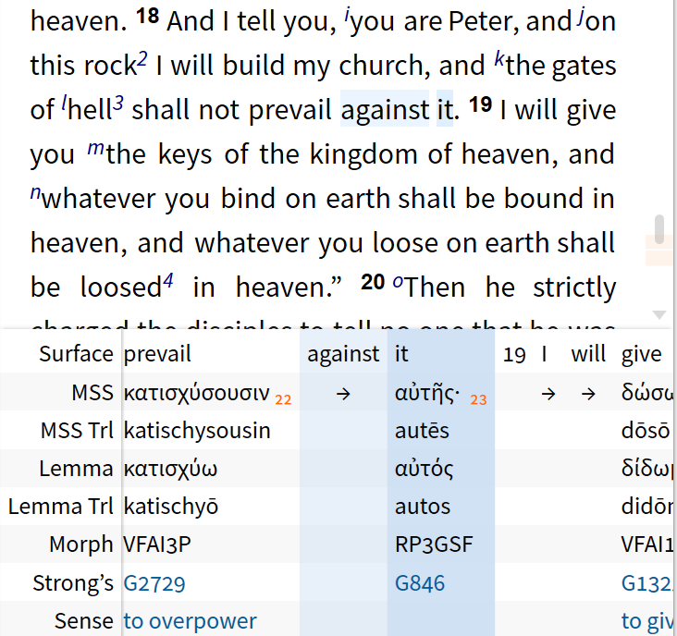
Jesus & Cosmic Geography
“against” not in original text (just verb + object);
better: “the gates of hell will not withstand it”

Slide 16
Jesus & Cosmic Geography
Mark 9:2-13 (Matt 17:1-8; Luke 9:28-36)
“And after six days Jesus took with him ﻿Peter and James and John, and led them up a high mountain”

Slide 17
Jesus & Cosmic Geography
Transfiguration
In early church tradition, the location of the mount of transfiguration was believed by many to be Mount Tabor.
The earliest witness to this tradition is the 4th century A.D.
The gospels themselves give no name, and so the tradition has no biblical precedent.

Slide 18
Jesus & Cosmic Geography
Mount Hermon is considered by many the better choice since it is much higher than Tabor (8,500 feet vs. 1,843 feet), which would fit better with the description of a “high mountain” by Mark (and in Matthew 17:1).
Avraham Negev, The Archaeological Encyclopedia of the Holy Land (3rd ed.; New York: Prentice Hall Press, 1996, c1990); “Tabor, Mount (Place),” ABD, 305.
Jesus and His World: An Archaeological and Cultural Dictionary; John J. Rousseau and Rami Arav (Fortress, 1995), 209-210

Slide 19
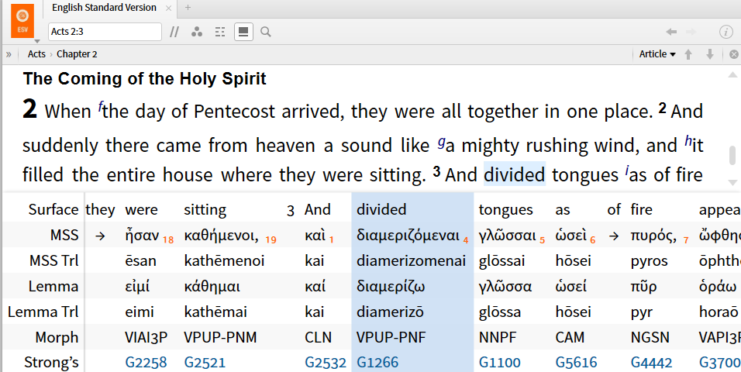
Acts - Cosmic Geography

Slide 20
Acts - Cosmic Geography
Acts 2 – Pentecost

Slide 21
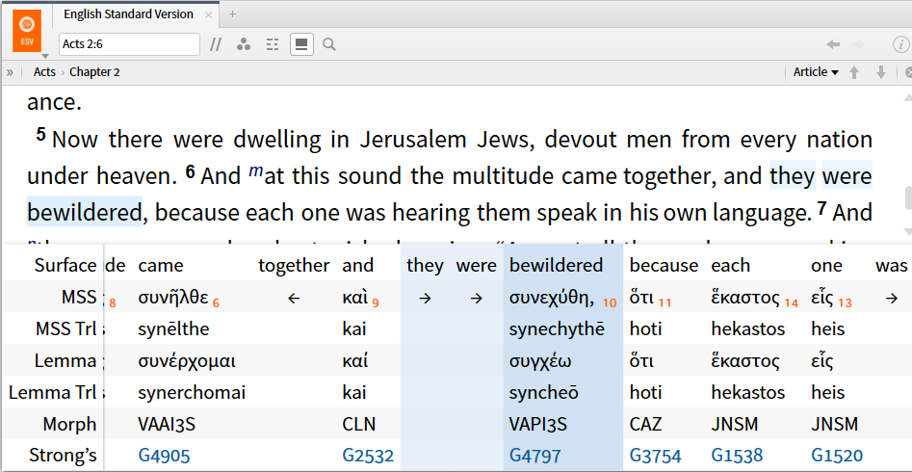
Acts - Cosmic Geography
Acts 2 – Pentecost

Slide 22
Acts - Cosmic Geography
Acts 2 – Pentecost

Slide 23
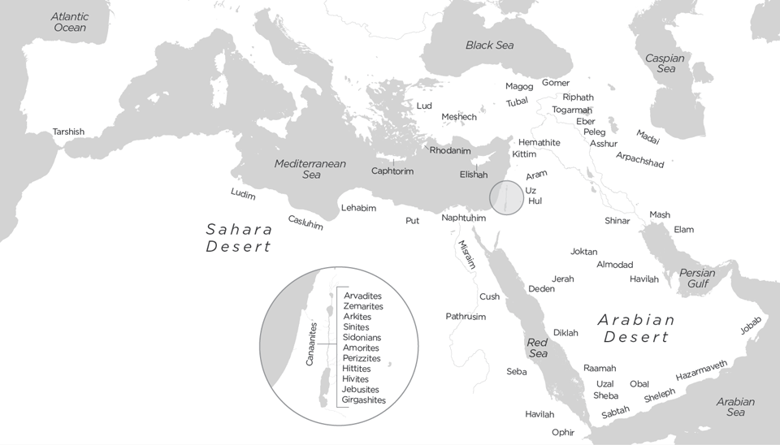
The Disinherited Nations (Gen 10)

Slide 24
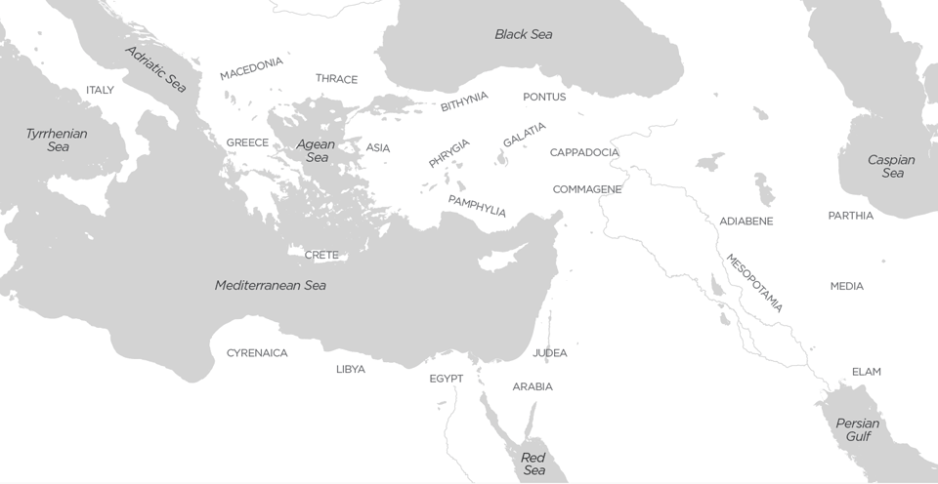
NT Cosmic Geography: Acts 2

Slide 25
NT Cosmic Geography
Acts 2 – Pentecost
Jerusalem > Judea > (Acts 2-8)
Samaria (Acts 8)
Ethiopian Eunuch (Acts 8)
Saul’s conversion (Acts 9) / Paul
Gentiles / Nations (cp. Isa 66)
Damascus (Acts 9)
Cornelius (Acts 10)
Missionary journeys to the nations (Acts 11-19)
Acts 20 – Paul’s arrest > Rome > Spain

Slide 26
Paul - Cosmic Geography
Rom 15:20 and thus I make it my ambition to preach the gospel, not where Christ has already been named, lest I build on someone else’s foundation . . . 23 But now, since I no longer have any room for work in these regions, and since I have longed for many years to come to you, 24 I hope to see you in passing as I go to Spain . . . 28 When therefore I have completed this and have delivered to them what has been collected, I will leave for Spain by way of you.

Slide 27
The Disinherited Nations (Gen 10)

Slide 28
Paul – Cosmic Geography
“rulers” (archontōn or archōn)
“principalities” (archē)
“powers” / “authorities” (exousia)
“powers” (dynamis)
“dominions” / “lords” (kyrios)
“thrones” (thronos)
“world rulers” (kosmokratōr)

Slide 29
Believer’s Destiny – Cosmic Geography
Believers are Sons and Daughters of God
Edenic Vision Restored
Divine Council Reconstituted

Slide 30
Sons and Daughters of God
John 1:12
1 John 3:1-3
Gal 3:26
Rom 8:14-17
Heb 2:10-13

Slide 31
Over the Nations
Revelation 2 [Jesus says]:
²⁵ Nevertheless, hold fast to what you have until I come. ²⁶ And the one who conquers and who keeps my works until the end, I will give him authority over the nations, ²⁷ and “he will shepherd them with an iron rod; he will break them in pieces like jars made of clay,” ²⁸ as I also have received from my Father, and I will give him the morning star.

Slide 32
Over the Nations
The morning star language in Rev. 2:28 is messianic—it refers to a divine being who would come from Judah.
We know this by considering two other passages in tandem.
In Num. 24:17, we read the prophecy that “a star will go out from Jacob, and a scepter will rise from Israel.”

Slide 33
Over the Nations
Later in the book of Revelation, Jesus himself refers to his messianic standing with the morning star language:
“I am the root and the descendant of David, the bright morning star” (Rev. 22:16).

Slide 34
Over the Nations
Revelation 3 [Jesus says]:
²⁰ Behold, I stand at the door and knock! If anyone hears my voice and opens the door, indeed I will come in to him and dine with him, and he with me. ²¹ The one who conquers, I will grant to him to sit down with me on my throne, as I also have conquered and have sat down with my Father on his throne.

Slide 35
1 Cor 6:2-3
Do you not know that the holy ones will judge the world? And if the world is to be judged by you, are you incompetent to try trivial cases? Do you not know that we are to judge angels?
YHWH / Godhead
sons of God
angels (messengers)

Slide 36
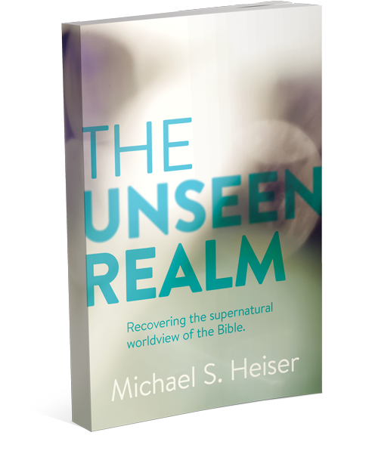
Naked Bible Podcast

