Slide 1
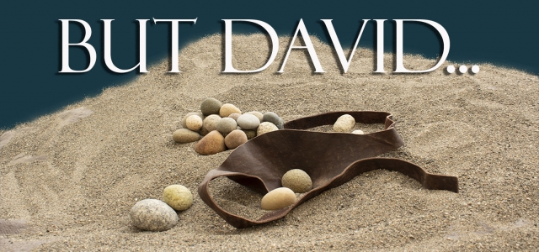

Slide 2
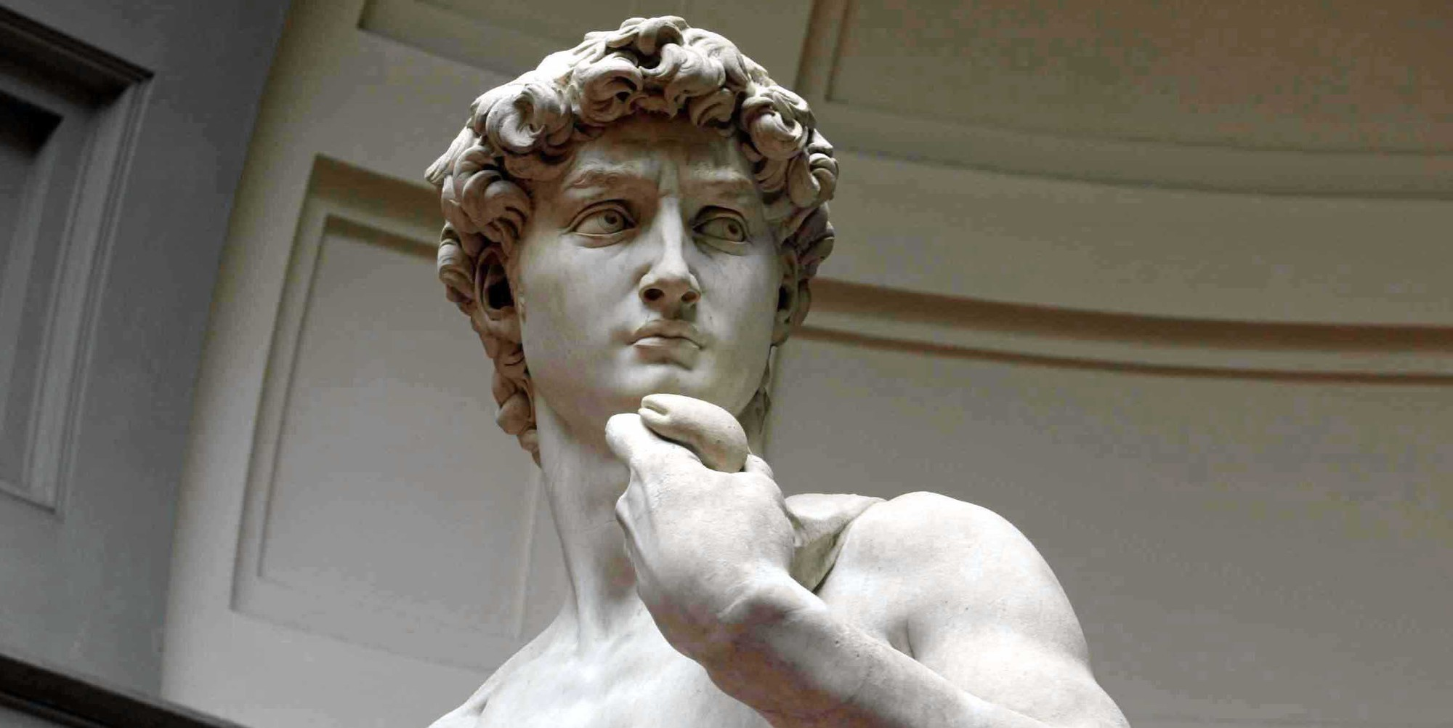
1- David’s Slingshot 2- David’s Respect 3- David’s Strength 4- David’s Sins 5- David’s Worship

Slide 3
David’s Strength

Slide 4
Have you ever found yourself in a new normal that you really don’t like?
You have to compromise.
Your choices are limited
You do things you swore you’d never do.

Slide 5
1 Sam 28:7-19 “7 The LORD has done to you as he spoke by me, for the LORD has torn the kingdom out of your hand and given it to your neighbor, David. 18 Because you did not obey the voice of the LORD and did not carry out his fierce wrath against Amalek, therefore the LORD has done this thing to you this day. 19 Moreover, the LORD will give Israel also with you into the hand of the Philistines, and tomorrow you and your sons shall be with me. The LORD will give the army of Israel also into the hand of the Philistines.””

Slide 6
1Sam. 30:1-6 “1 Now when David and his men came to Ziklag on the third day, the Amalekites had made a raid against the Negeb and against Ziklag. They had overcome Ziklag and burned it with fire 2 and taken captive the women and all who were in it, both small and great. They killed no one, but carried them off and went their way. 3 And when David and his men came to the city, they found it burned with fire, and their wives and sons and daughters taken captive. 4 Then David and the people who were with him raised their voices and wept until they had no more strength to weep. 5 David’s two wives also had been taken captive, Ahinoam of Jezreel and Abigail the widow of Nabal of Carmel. 6 And David was greatly distressed, for the people spoke of stoning him, because all the people were bitter in soul, each for his sons and daughters. But David strengthened himself in the LORD his God.”

Slide 7
Discontentment is not a symptom of injustice, it’s a symptom of idolatry.

Slide 8
Philippians 4:12-13 “I know what it is to be in need, and I know what it is to have plenty. I have learned the secret of being content in any and every situation, whether well fed or hungry, whether living in plenty or in want. 13 I can do everything through him who gives me strength.”

Slide 9
Think Kairos not Chronos

Slide 10
Hebrews 4:16 “Let us then with confidence draw near to the throne of grace, that we may receive mercy and find grace to help in time of need.”

Slide 11
2. Margin

Slide 12
Living without margin is a symptom of you trying to replace God with something else.

Slide 13
3. Not an Internal Strength

Slide 14
1Sam. 30:7-8 “7 And David said to Abiathar the priest, the son of Ahimelech, “Bring me the ephod.” So Abiathar brought the ephod to David. 8 And David inquired of the LORD, “Shall I pursue after this band? Shall I overtake them?” He answered him, “Pursue, for you shall surely overtake and shall surely rescue.””

Slide 15
Churchill “Success is not final, failure is not fatal: it is the courage to continue that counts.”

Slide 16
Psalm 23

